Slide 1
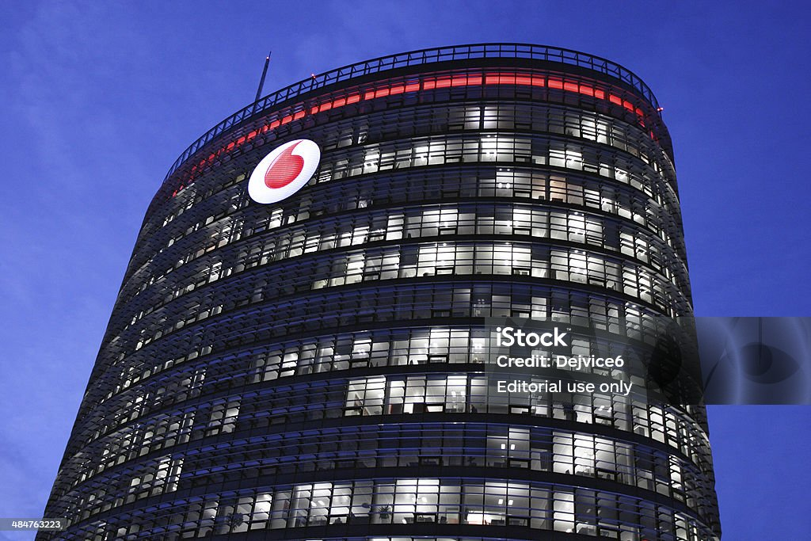
Decoding Student Retention and Churn Predictive Analytics of Vodafone(Telecel) in Knust

Slide 2

Introduction
The telecommunications industry in Ghana has experienced significant growth in recent years, with companies like Vodafone Ghana (now Telecel) playing a crucial role in providing mobile and internet services nationwide. However, the industry is highly competitive, making customer retention essential for maintaining market share and profitability. This study aims to investigate the factors influencing student churn and retention among KNUST students using Telecel services. By understanding these factors, Telecel can develop effective strategies to mitigate churn and enhance student retention.

Slide 3

Problem Statement
Despite the partnership between KNUST and Telecel, the school-provided SIM card program faces significant challenges with high rates of student churn. This results in substantial revenue loss and negatively impacts student experiences. The primary problem lies in the lack of understanding of the factors driving student churn and retention.

Slide 4

Research Objectives
- Explore factors influencing student churn and retention among KNUST students using Telecel services.
Identify how Telecel network and service quality influence student retention and churn.
- Develop strategies to improve retention rates and reduce churn among KNUST students.

Slide 5
Significance of the Study
This study will provide insights into the factors impacting student retention and churn for Telecel. By identifying these factors, Telecel can develop targeted strategies to enhance retention rates and minimize churn, benefiting both the company and KNUST students.

Slide 6
Literature Review
The literature review will synthesize existing research on customer retention and churn in telecom services and student populations. Key concepts, theoretical frameworks, and empirical studies will be examined to identify factors influencing customer retention and churn.

Slide 7
Conceptual Review
A conceptual framework will be proposed to illustrate the relationships between key factors influencing customer retention and churn for Telecel services at KNUST.

Slide 8


Slide 10
Summary
This literature review provides a solid foundation for developing a predictive analytics model to identify key drivers of customer retention and churn for Telecel at knust

Slide 11

Thank You

